Slide 1
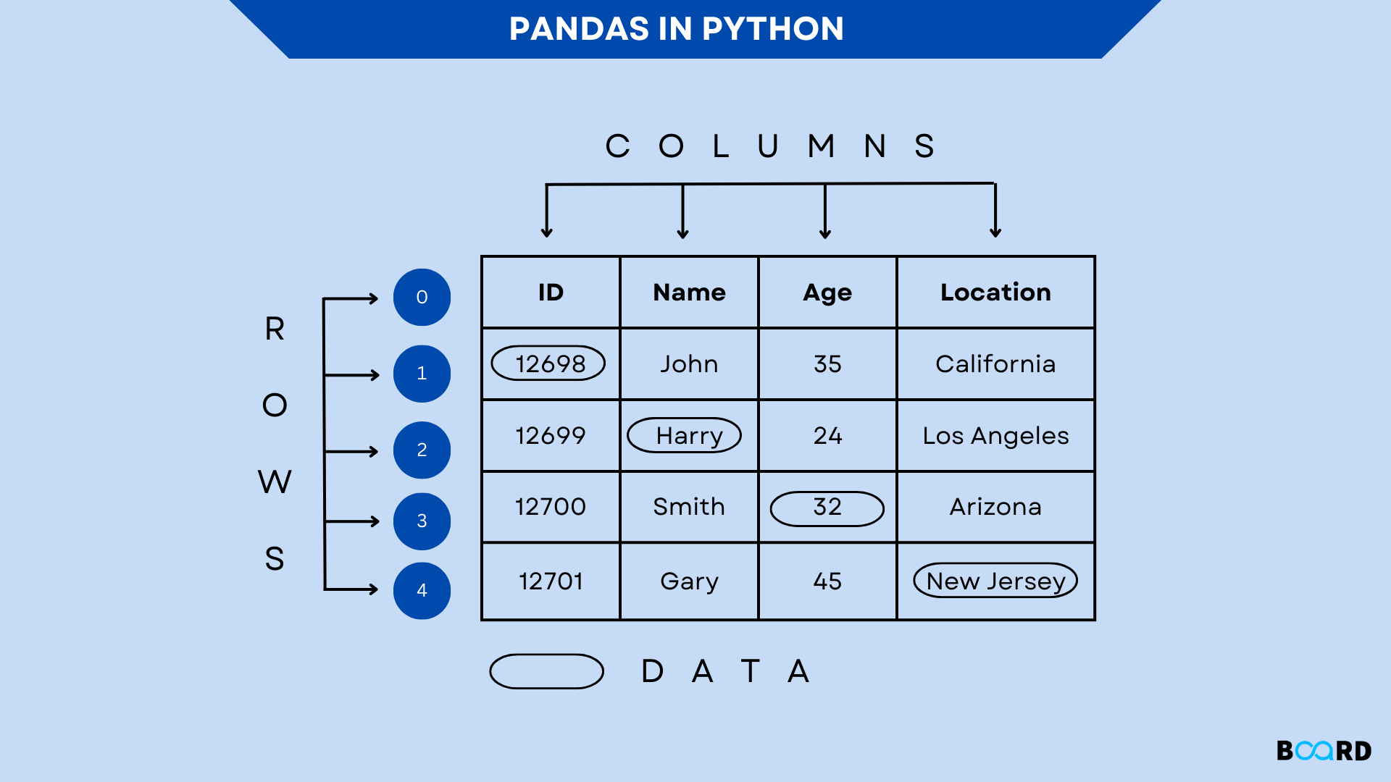
The Anatomy of Pandas
Series (1D): Think of this as a single column in an Excel sheet. It is an array of data with an associated label called an index.
DataFrames (2D): The primary tool for data analysis. It is a collection of Series sharing the same index. It represents the standard "Table" format used in almost every industry.
The Power of Labels: Unlike NumPy, where you must remember index [0, 1], Pandas allows you to access data by names like 'Price' or 'Date'

Slide 2
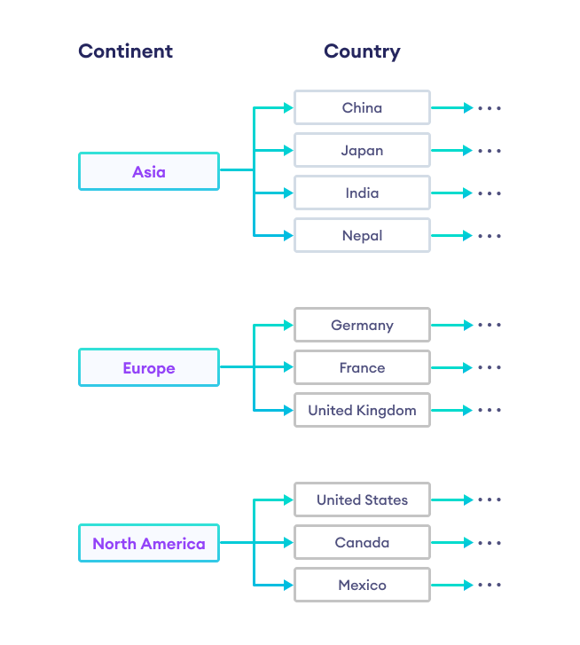
Multi-Indexing (Hierarchical Data)
Beyond 2D: What if your data has layers? (e.g., Data for multiple Cities, collected over multiple Years, across different Months).
Organization: Multi-indexing allows you to store and query high-dimensional data in a 2D table format.
Regional Use Case: This is essential for "Regional Analytics," such as comparing agricultural yields across different districts in KPK over a 10-year span.

Slide 3
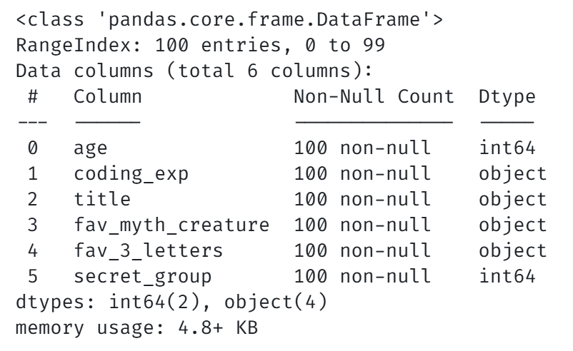
Categorical Data: The Invisible Speed Boost
The Problem: Storing the word "Peshawar" 1 million times as a string is a waste of memory.
The Solution: The category data type stores the unique string once and uses small integers to represent the repetitions.
Impact: This can reduce file sizes by up to 90% and speed up grouping operations significantly.

Slide 4
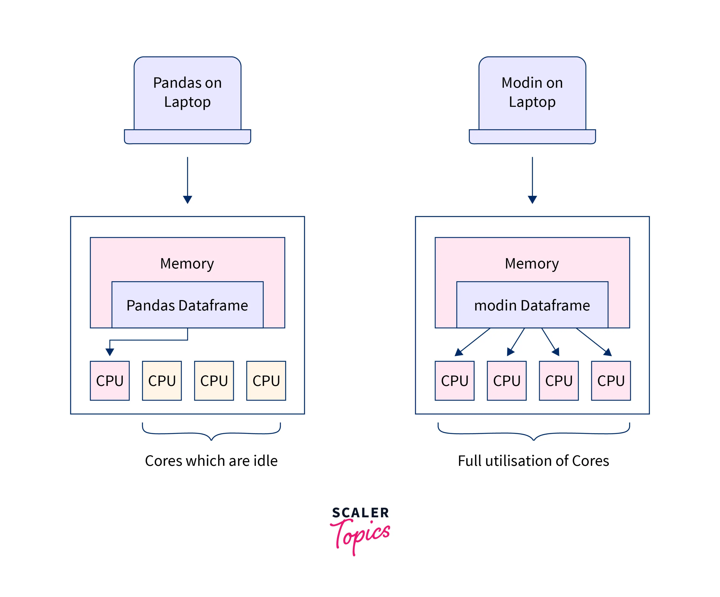
Memory Optimization & Scaling
The Laptop Limit: Standard laptops crash when a dataset exceeds available RAM.
Downcasting: Converting float64 to float32 or int64 to int16.
Efficient Loading: Only loading the columns you need. We teach these techniques so you can process millions of rows on standard hardware.

